Slide 2
A One Day Invitation Only Summit
“Safe and Affordable Housing for Seniors
with Low Incomes”
An Invitation Only Summit
Friday, March 16, 2018
The Leonard Davis Institute
3641 Locust Walk #210
Philadelphia, PA 19104

Slide 4
Table of Contents
Goals of the Summit
The Problem: Lack of Safe and Affordable Housing for
Seniors with Low Incomes
Potential Solution(s)
The Way Forward

Slide 5
Goals of the Summit
To heighten awareness of the tremendous and growing need for safe and affordable housing opportunities for seniors with low incomes
To heighten awareness of the significant relationship between housing and the overall health and social needs of low income seniors and the costs implications to our society of not recognizing and responding effectively
To utilize the tremendous experience, knowledge and vision of those attending the Summit and allow this gathering to serve as a catalyst to support and expand existing efforts and to create new models for meeting the needs of our nation’s growing number of seniors with low incomes.
4

Slide 6
The Problem(s): Assuring Safe and Affordable Housing for Seniors with Low Incomes
Addressing this issue is no small undertaking... and in fact,
opens the door to many additional “problems” that can not be ignored if indeed the goal is to successfully increase the availability of safe and affordable senior housing for seniors with low incomes...

Slide 7
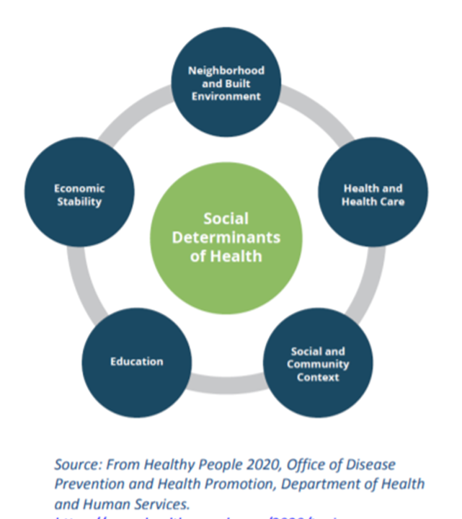
The Social Determinants of Health
Senior Housing

Slide 8
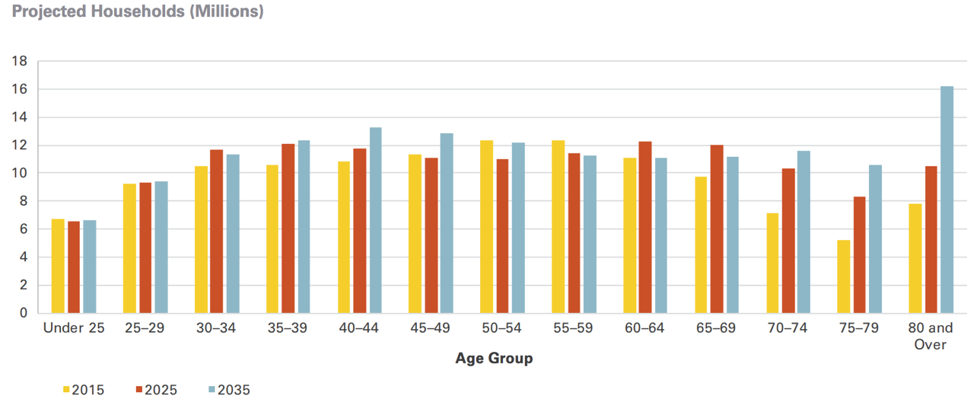
The State of Affordable Senior Housing Today
Over the next twenty years, the population aged 65 and over is expected to grow from 48 million to 79 million
The number of households headed by someone in that age group will increase by 66 percent to almost 50 million — by 2035, one out of three American households will be headed by someone aged 65 or older

Slide 9
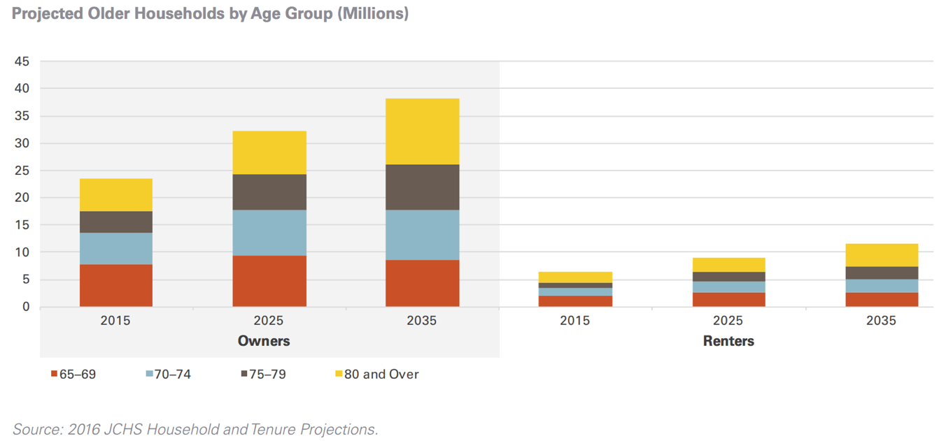
State of Affordable Senior Housing Today
The expansion of the older population will increase the need for affordable, accessible housing that is well-connected to services well beyond what current supply can meet

Slide 10
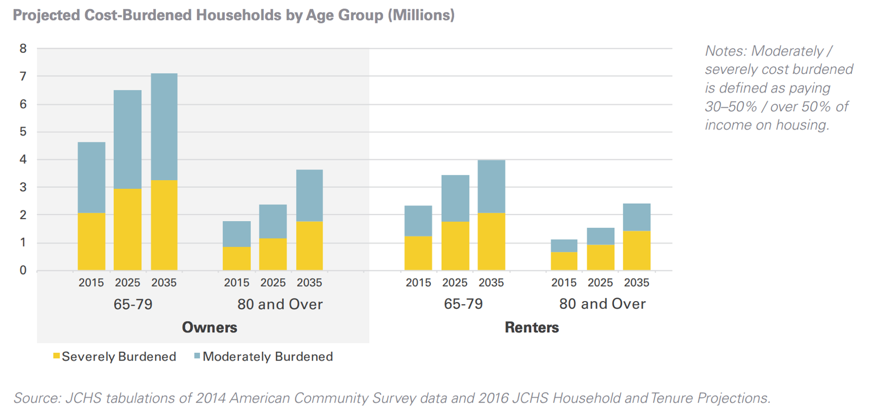
Cost-Burdened Senior Households Will Increase

Slide 11
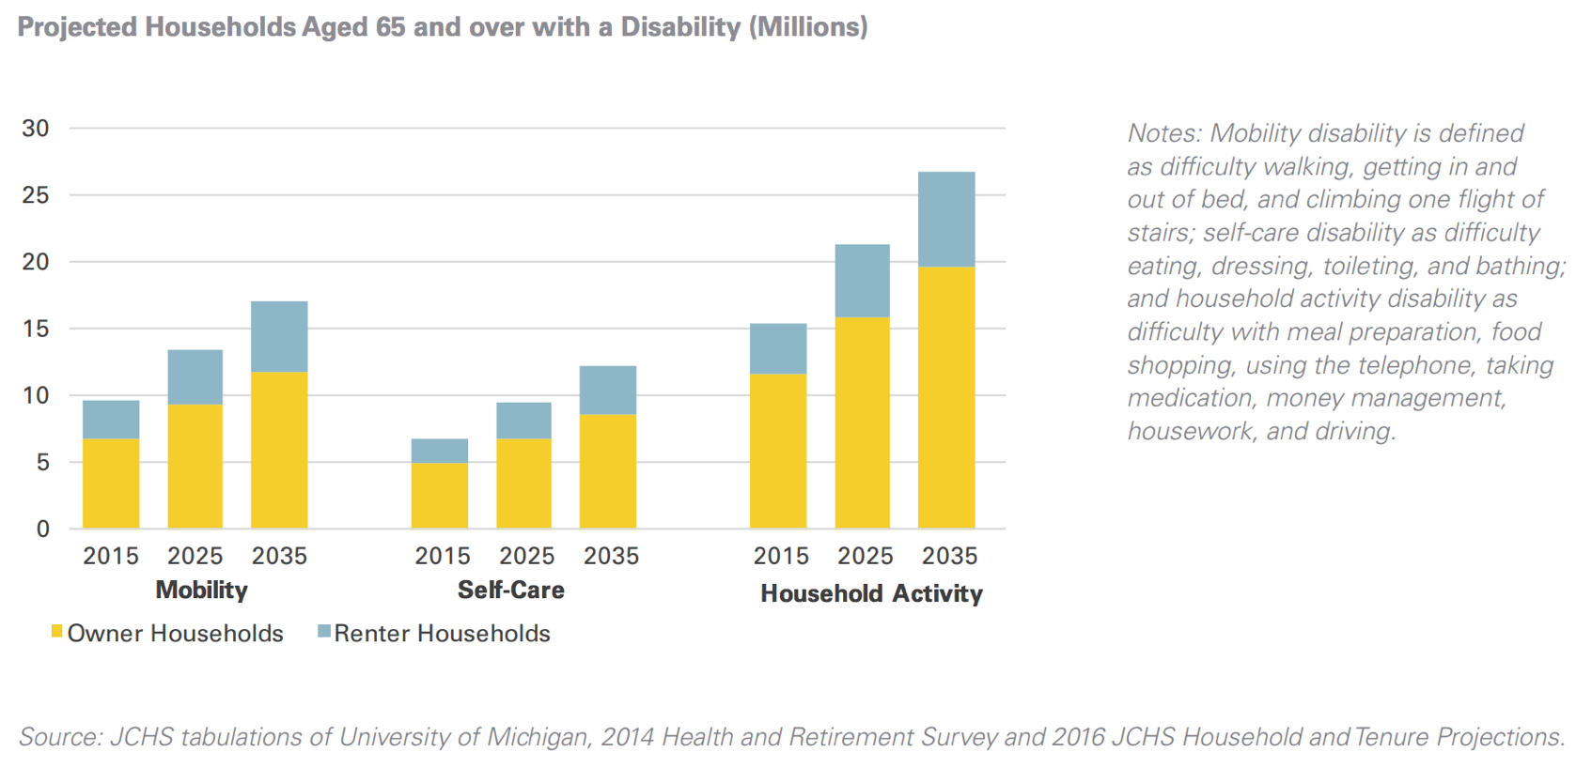
A Growing Older Population Means
More Households With Disabilities
By 2035, 17 million older adult households will have at least one person with a mobility disability, for whom stairs, narrow corridors and doorways, and traditional bathroom layouts will pose challenges to safety and independence

Slide 12
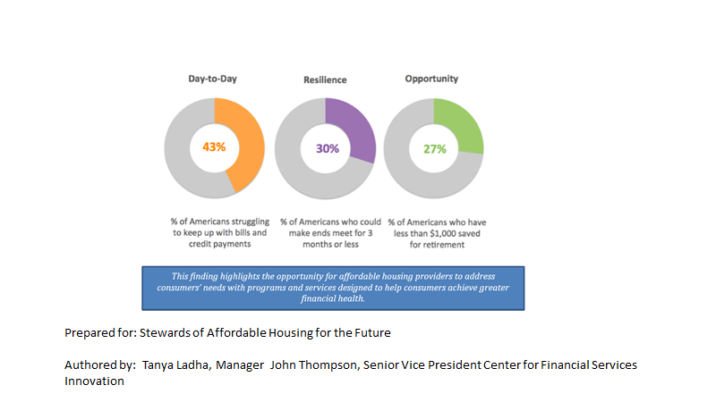
The Current Economic Realities of Society
are predictors of the Future

Slide 13
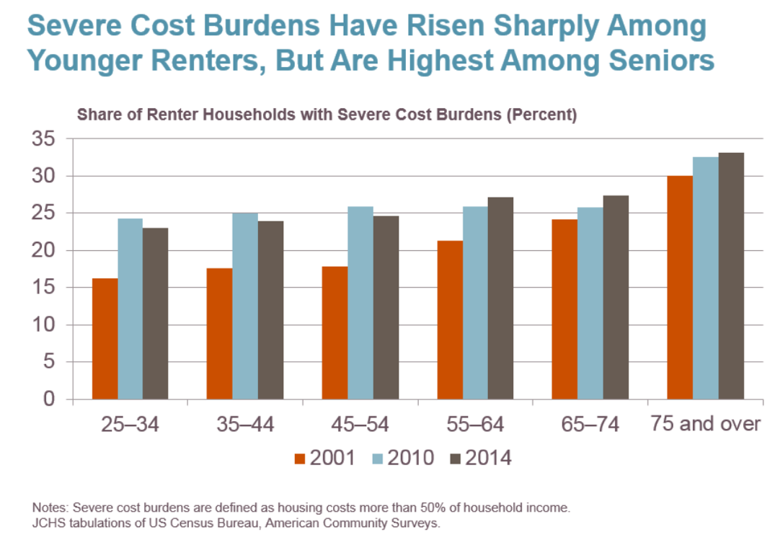
Housing Affordability is a Serious Concern
The high levels of severe housing cost burdens are particularly extreme for older adults today

Slide 14
Most Homes Today Do Not Have
Accessibility Features
Less than 4 percent of single family homes, the most common form of housing for older adults, offer three of the most critical accessibility features (single-floor living, extra-wide hallways and doors, and zero-step entrances)
Renters more likely than owners to have mobility disabilities yet less control
While 12.2 million households are projected to have self-care disabilities by 2035, nearly 10 percent of all older homeowner households have less than $50,000 in total assets
A large percent of older adults will need financial
assistance to modify their homes

Slide 15
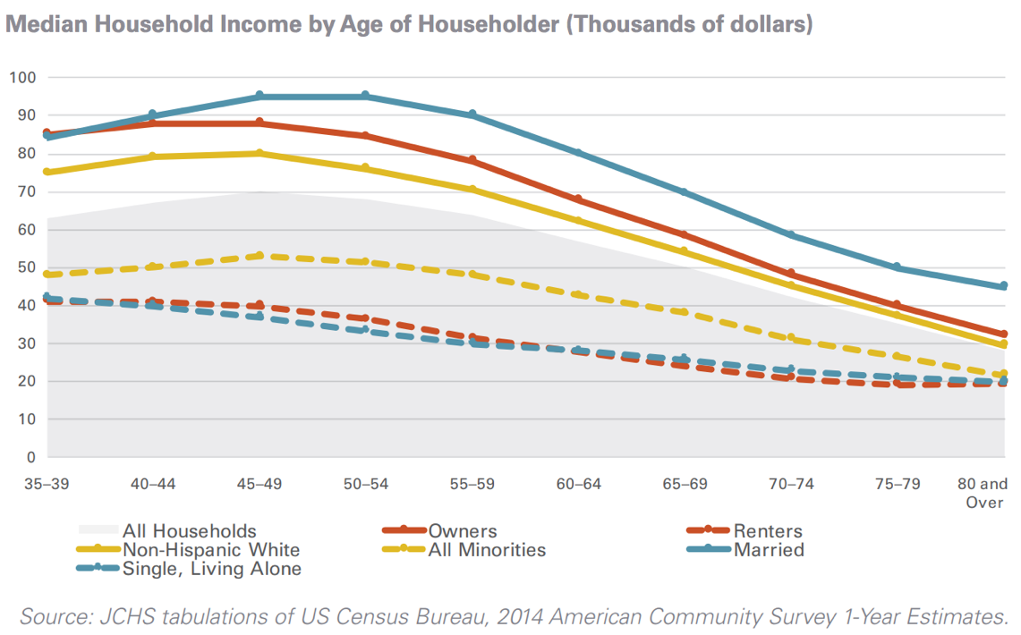
Senior Populations Have Lower Incomes
Median income declines with age for nearly every segment of the older population
Notes:
¹Optimal dose and route of administration of MTX in RA: a systematic review of the literature (Annals of the Rheumatic Diseases 2008)

Slide 16
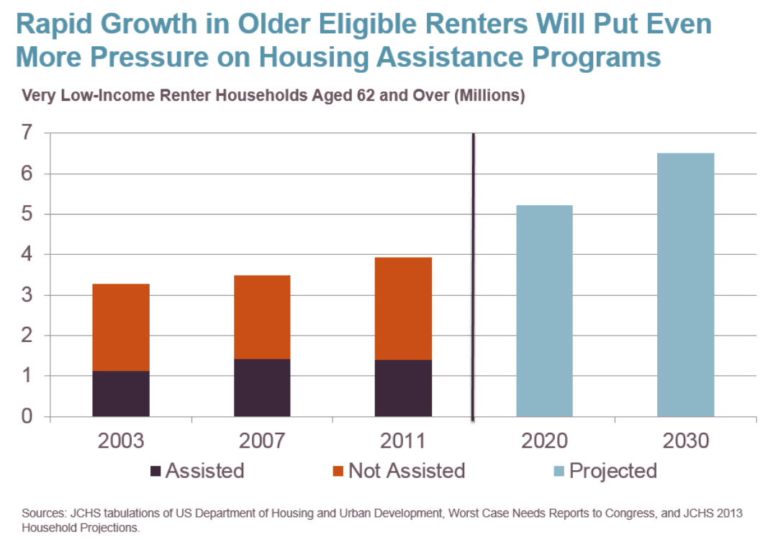
Dearth of Housing Assistance Programs for Older Renters
Our nation’s housing assistance programs fail to provide most very low income older adults with a housing safety net today and, projected, for older adults tomorrow
Majority of calls to PCA and the City of Philadelphia’s hot lines are seeking help in finding low income housing!

Slide 17
Limited Availability of Senior Housing leads to Higher SNF Admissions in Many Markets
Good for the nursing home industry!
Not so good for the senior
Terrible for unnecessarily increasing our nation’s cost
Community based care much less expensive than institutional care

Slide 18
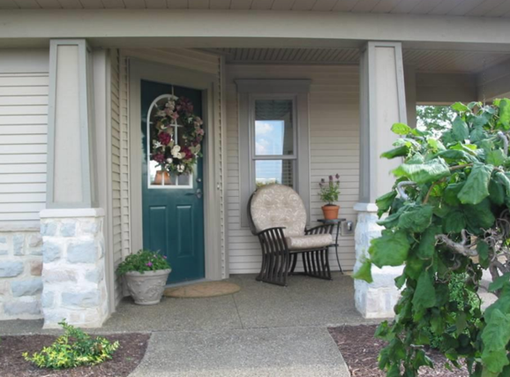
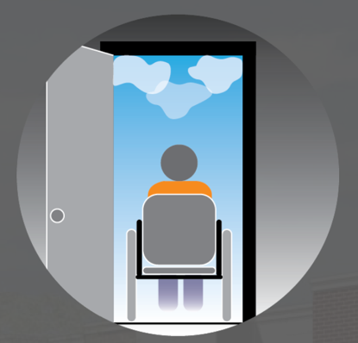
Demand For Accessible Housing Will Increase
Housing design features that increase accessibility can allow those with mobility disabilities to stay in their homes longer
Design elements such as:
Zero-step entrances
Single-floor living
Wide halls/doorways that can accommodate a wheelchair
Electrical controls reachable from a wheelchair
Lever-style handles on faucets and doors
Only 1 percent of the current housing stock offers all five of these features

Slide 19
State of Affordable Senior Housing
in Philadelphia Today
70% of Philadelphia seniors own their homes, which need new roofs, electrical systems, plumbing, windows, and more
66% of senior homeowners report that it is difficult or very difficult to afford maintenance and repairs, especially when they are struggling to pay for basic necessities, such as medicine and food
The Philadelphia Corporation for Aging (PCA) delivers approximately
5,000 meals a day to low income seniors in Philadelphia … without
this program, many of these vulnerable seniors would not have food.

Slide 20
Potential Solution(s)
Just as the senior population represents an
amazing array of “differences” so to, there are many potential solutions when looking at ways of improving access to safe and affordable housing for seniors with low incomes.
One consistent factor however …. We need to be thinking from more of a holistic and systematic perspective to effectively generate realistic solutions!

Slide 21
A Unique Entrepreneurial Opportunity
The HPCCCS Program

Slide 22
An Alternative Senior Housing Program
The Hurricane Proof
Customized Cargo Container
Senior Apartment

Slide 23
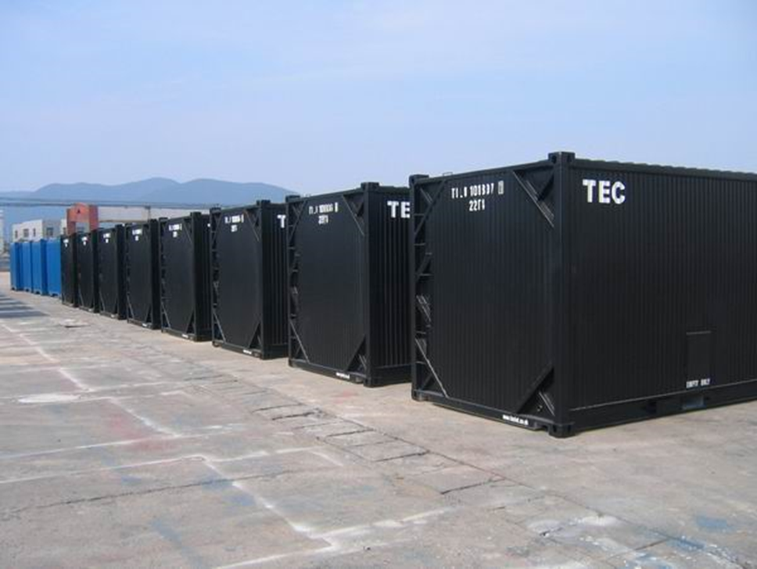
Mom’s New Apartment!

Slide 24
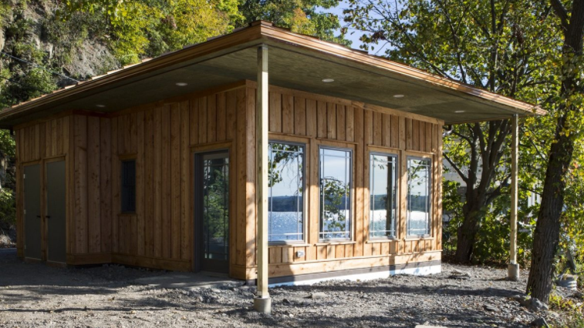
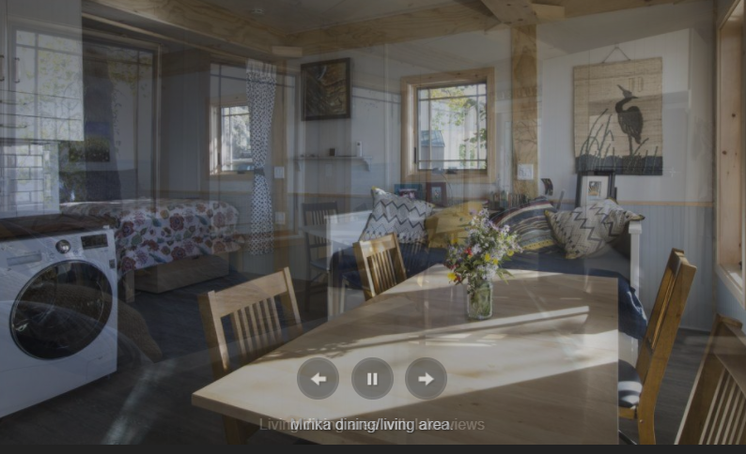
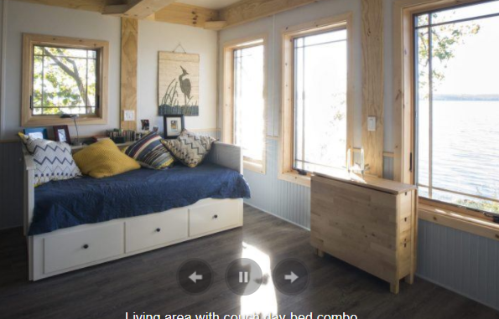
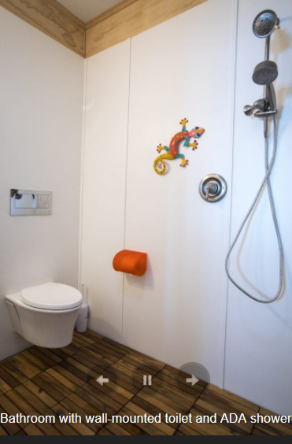
The Minca House

Slide 25
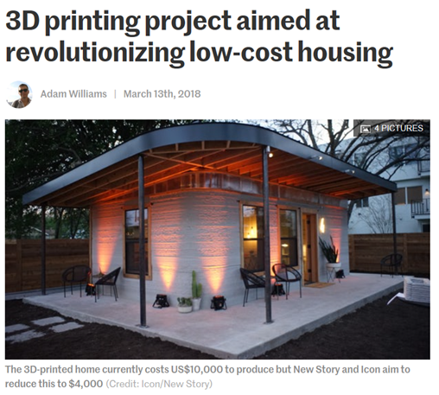

Slide 26
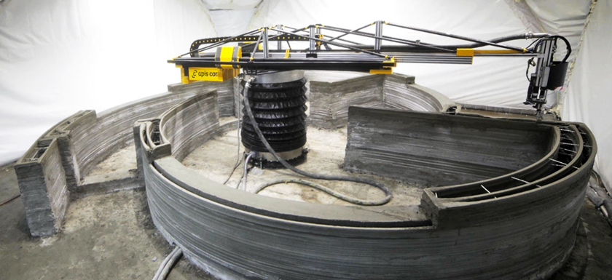
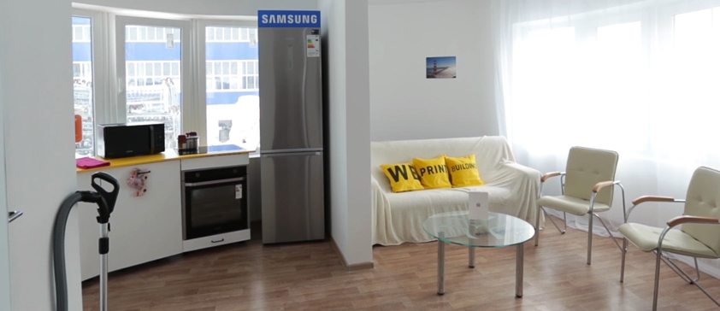
3-D Printing Homes
Can we decrease the cost of building senior housing and increase the supply of affordable senior housing through technology?
One of the more fascinating opportunities is the ability to use 3-D printers to build safe and inexpensive homes
Actual construction costs of a 3-D built home is under $10,000 and can be completed in under 24 hours

Slide 27
U-Tube of 3-D Printing of homes

Slide 28
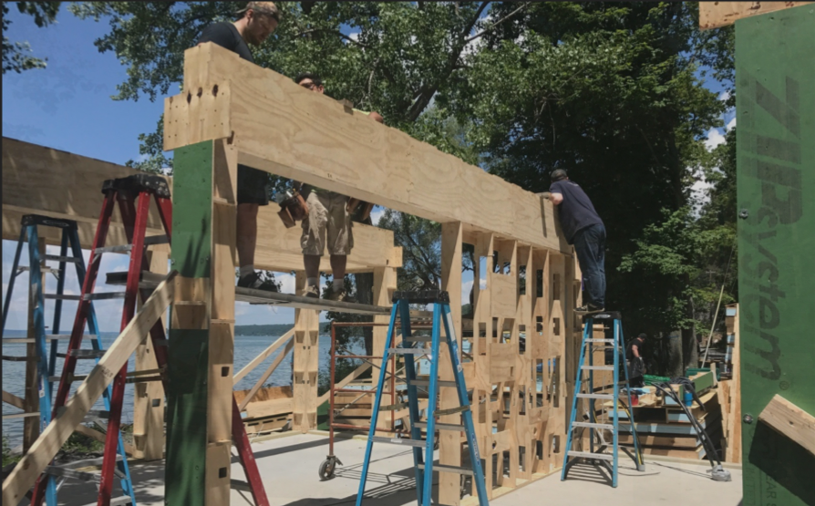
Alternative Models? MAGIC Housing
MAGIC: Multi-Ability/Multi-Generational Inclusive Communities (Dr. Bill Thomas)
The first MAGIC development is being constructed at the University of Southern Indiana in Evansville
The plans for MAGIC rest in part on a new type of housing: small homes built through modular construction, enabled with technologies to help seniors and others who need support to live independently

Slide 29
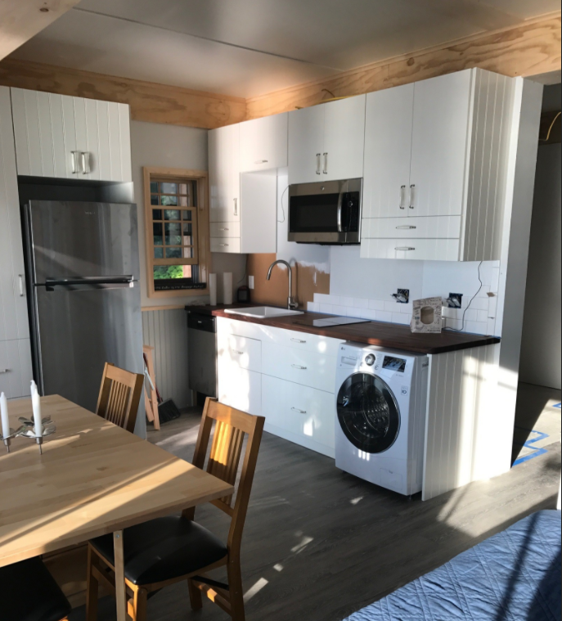
Alternative Models? MAGIC Housing
One of the most obvious defining features of a Minka is its small size.
The smallest Minka footprint could be as small as 325 square feet, with a sleeping area, kitchen and bathroom that is fully accessible under Americans With Disabilities Act guidelines
At this size, a Minka could be built as an accessory dwelling on the same property as a family’s existing home

Slide 30
Alternative Models? MAGIC Housing
The University of Southern Indiana (USI) is in need of new student housing. Rather than building a traditional dormitory, however, it has chosen to be the site of the first MAGIC community.
The idea is to create housing for different generations and abilities all in the same cluster on campus. Minka homes likely will be part of this cluster

Slide 31
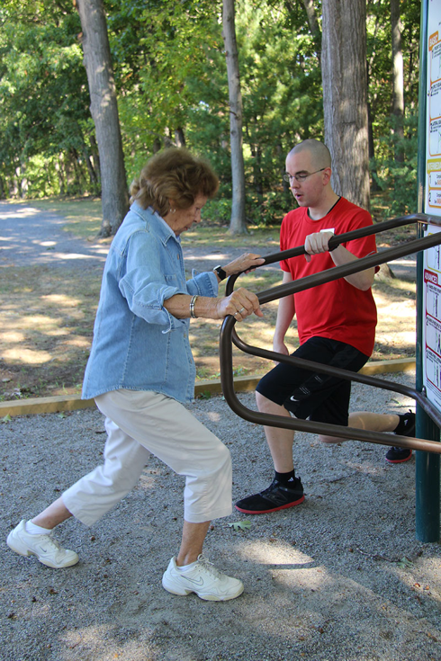
Alternative Models? Why Universities are Getting into Senior Housing
Newton, Mass.-based Lasell Village, located on the campus of Lasell College
The Village in Gainesville, which announced a partnership in 2014 with University of Florida
These partnerships function in different ways and have different goals, but increasingly, universities are becoming more interested in senior living, and vice versa, for the mutual benefits that they can realize.

Slide 32
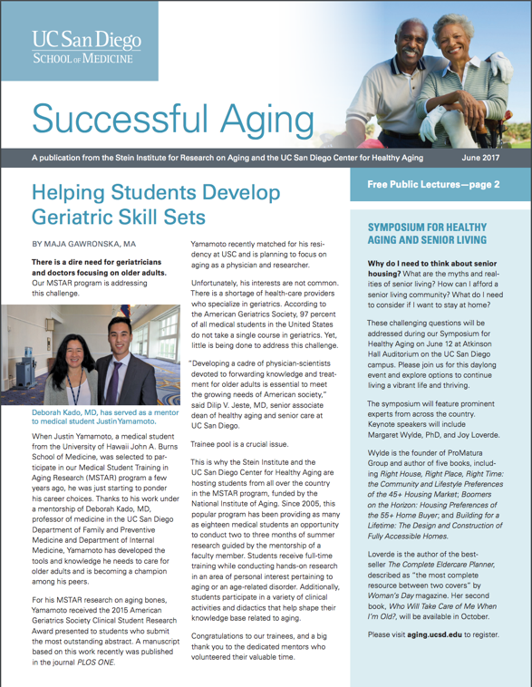
Alternative Models? Why Universities are Getting into Senior Housing
The University of California’s Stein Institute for Research on Aging, and Center for Healthy Aging
Q: What is the interest of an institution like UC San Diego in the development of senior housing?
A: The population of older adults is increasing, but the number of geriatric trained health care providers is not only stagnant, but in some cases (e.g., geriatric medicine and geriatric psychiatry) it is actually going down.
How can we care for the growing number of older people who have greater healthcare needs when there are not enough clinicians to take care of them? We have to come up with new models.
Universities are not just for science and publishing papers. We are here to help the community and enhance its well-being.

Slide 33
How about the University of Pennsylvania?
Combination of student dorms, faculty retirement, low income housing
Combined with retail stores and restaurants
An nurse practitioner clinic that served the complex and the community
A research center that brought students and entrepreneurs together with
seniors … one of our nation’s greatest resources
Instead of building more stand alone senior housing programs, why not look for more of a holistic or systems approach?

Slide 34
How about Managed Care Programs?
Reality: Many seniors needing or residing in low income housing are often dual eligible and high users of health care costs
Possibility: Managed care companies could take an active part in developing low income housing equipt with monitoring capabilities, case management, onsite services, etc.
Outcomes: Improved quality of life for seniors and reductions in health care spending generating greater returns for the managed care company

Slide 35
The Way Forward
We know where we are…
We have generated consensus on one or more creative ideas to address the need for safe and affordable housing for seniors with low incomes…
What steps are needed to allow these ideas to be tested and proven?
How do we make them a valuable part of the solution?

Slide 36
